Slide 1

Cloud Workshop
Cloud Technology Essentials

Slide 2


Outline
Networking
1
2
Cloud
Deployment
3
4
Breakout
More on Cloud
5
6
Q & A

Slide 3
?
What did just happened?

Slide 4




Networking
Essential Basics
How information is transmitted over computer networks, network architecture, HTTP, APIs, and web applications
Notes:
Please, replace the image with a more suitable. Avoid removing the blue shape!

Slide 5

Networking Objectives
Layers of Networking
Data exchange in the Internet
Web applications
Requests and responses API
Flask

Slide 6
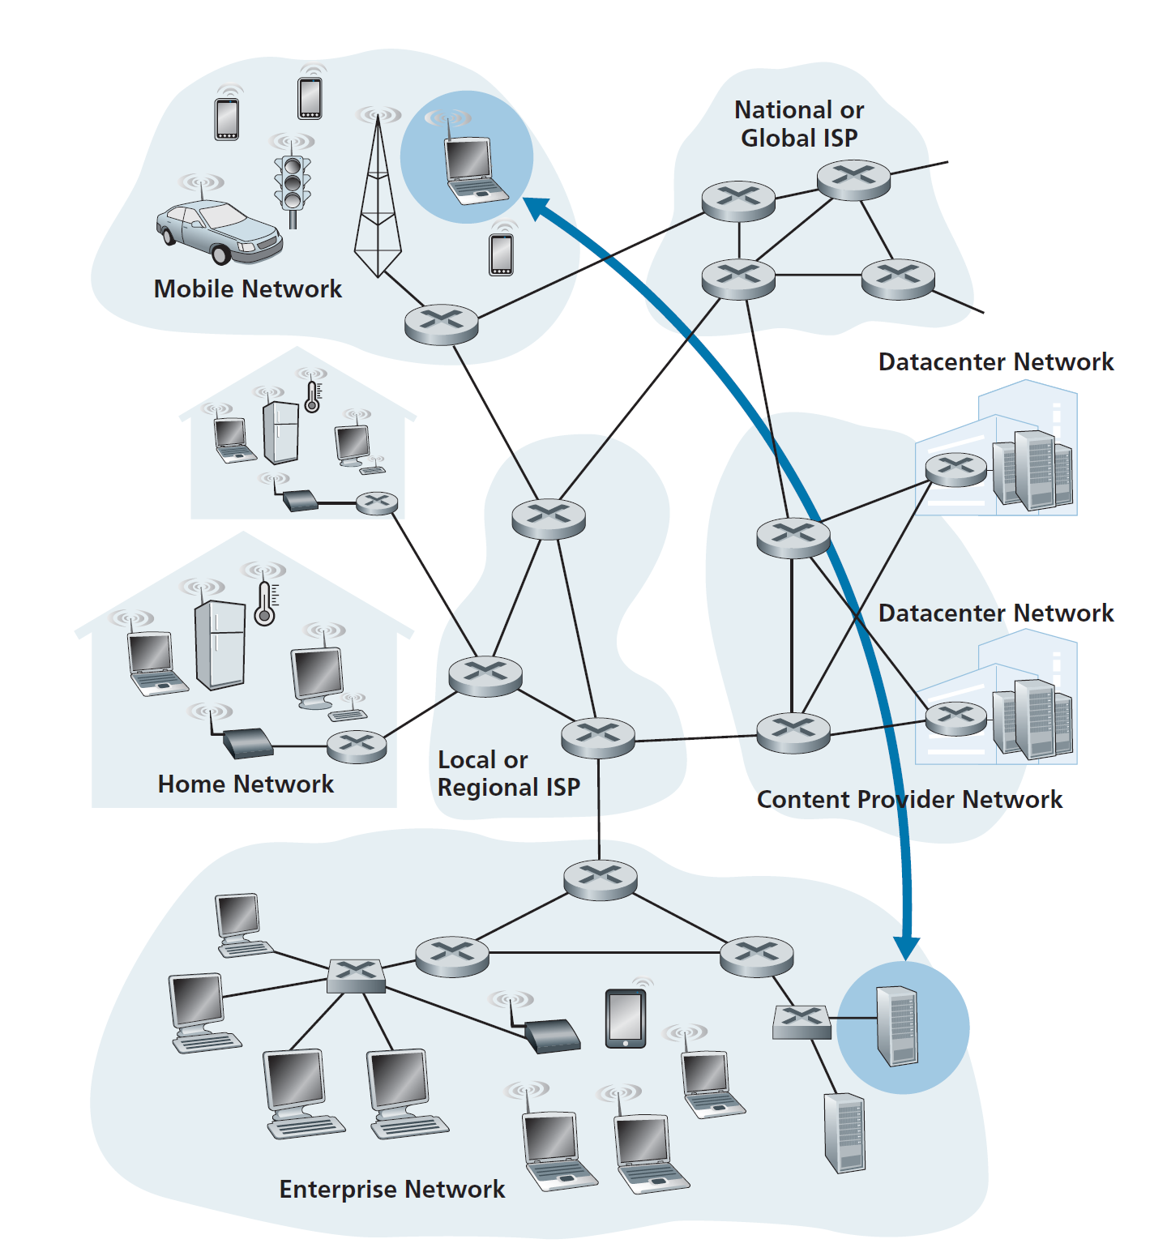

Slide 7


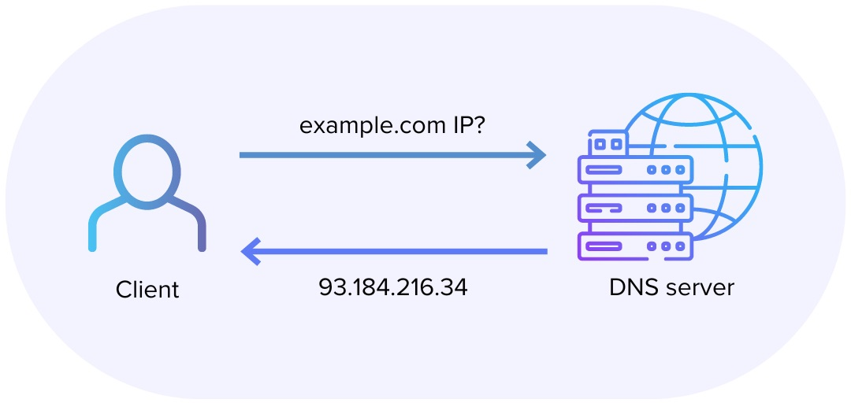
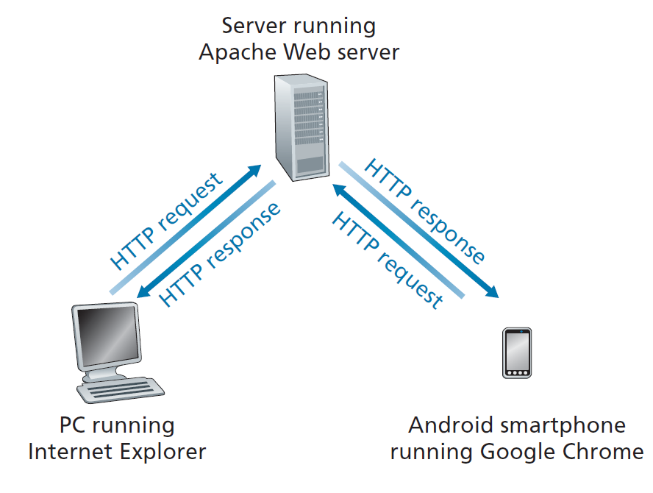
Request - Response
HTTP Methods:
GET, POST, PUT, DELETE

Slide 8
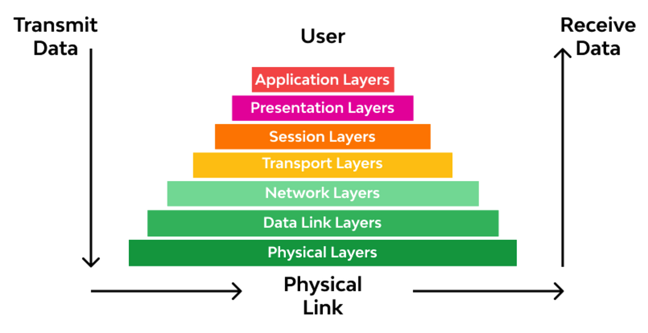
Layers of Networking

Slide 9
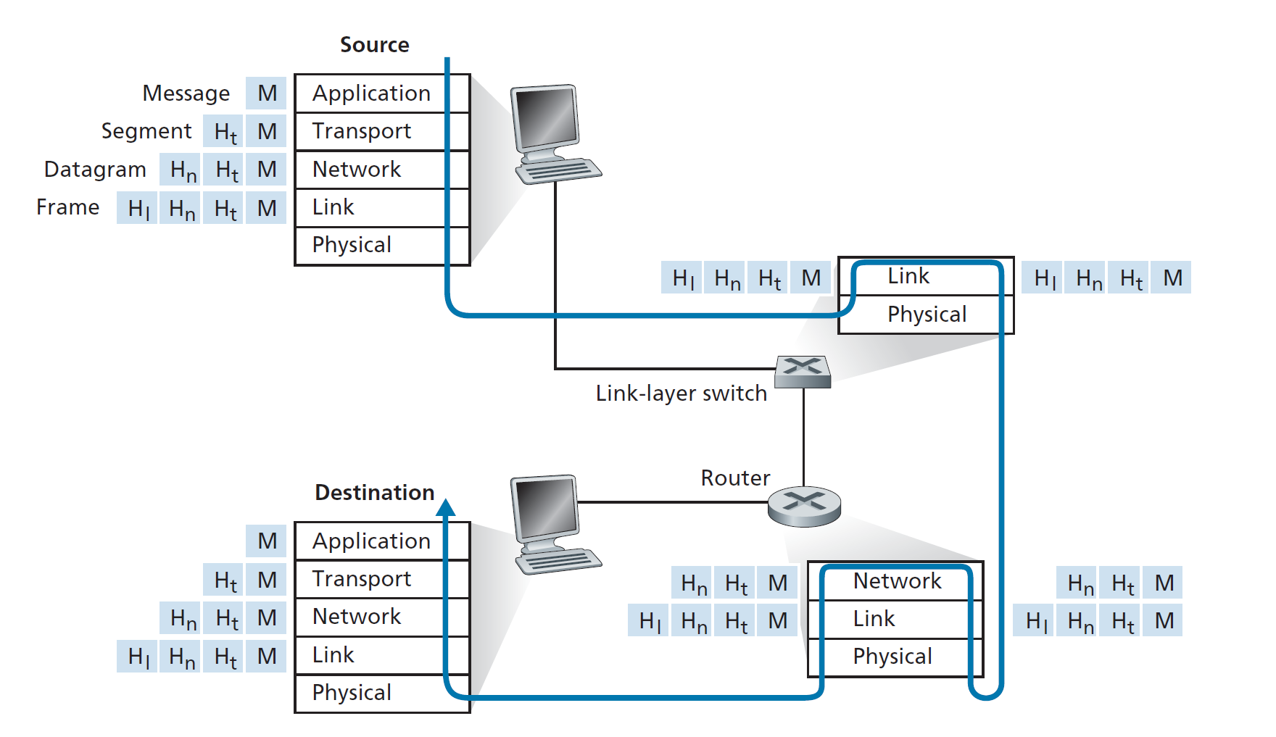

Slide 10
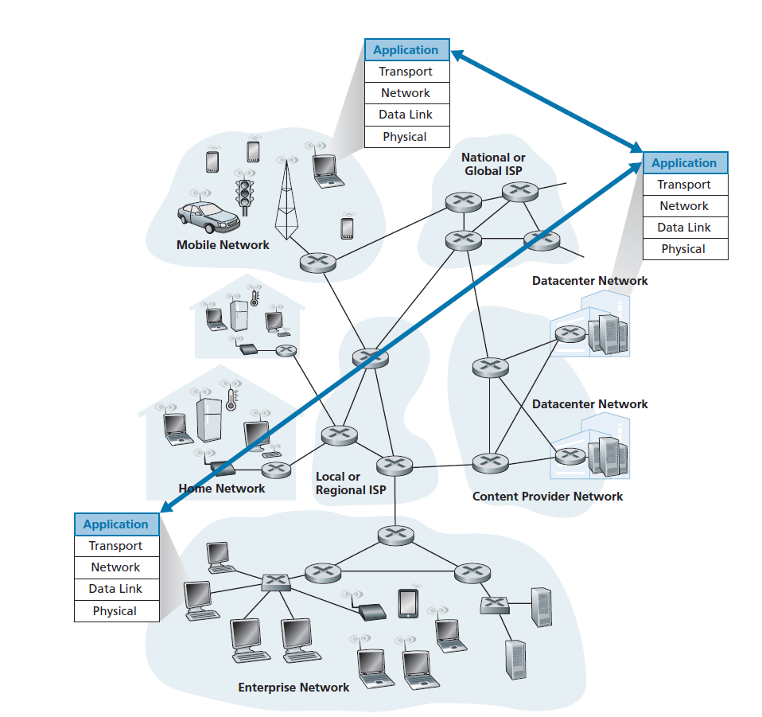
Network Architecture
End-system interaction

Slide 11
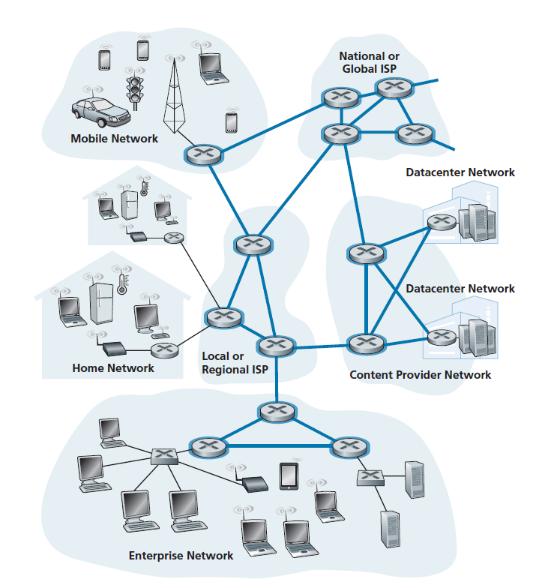
Network core

Slide 12
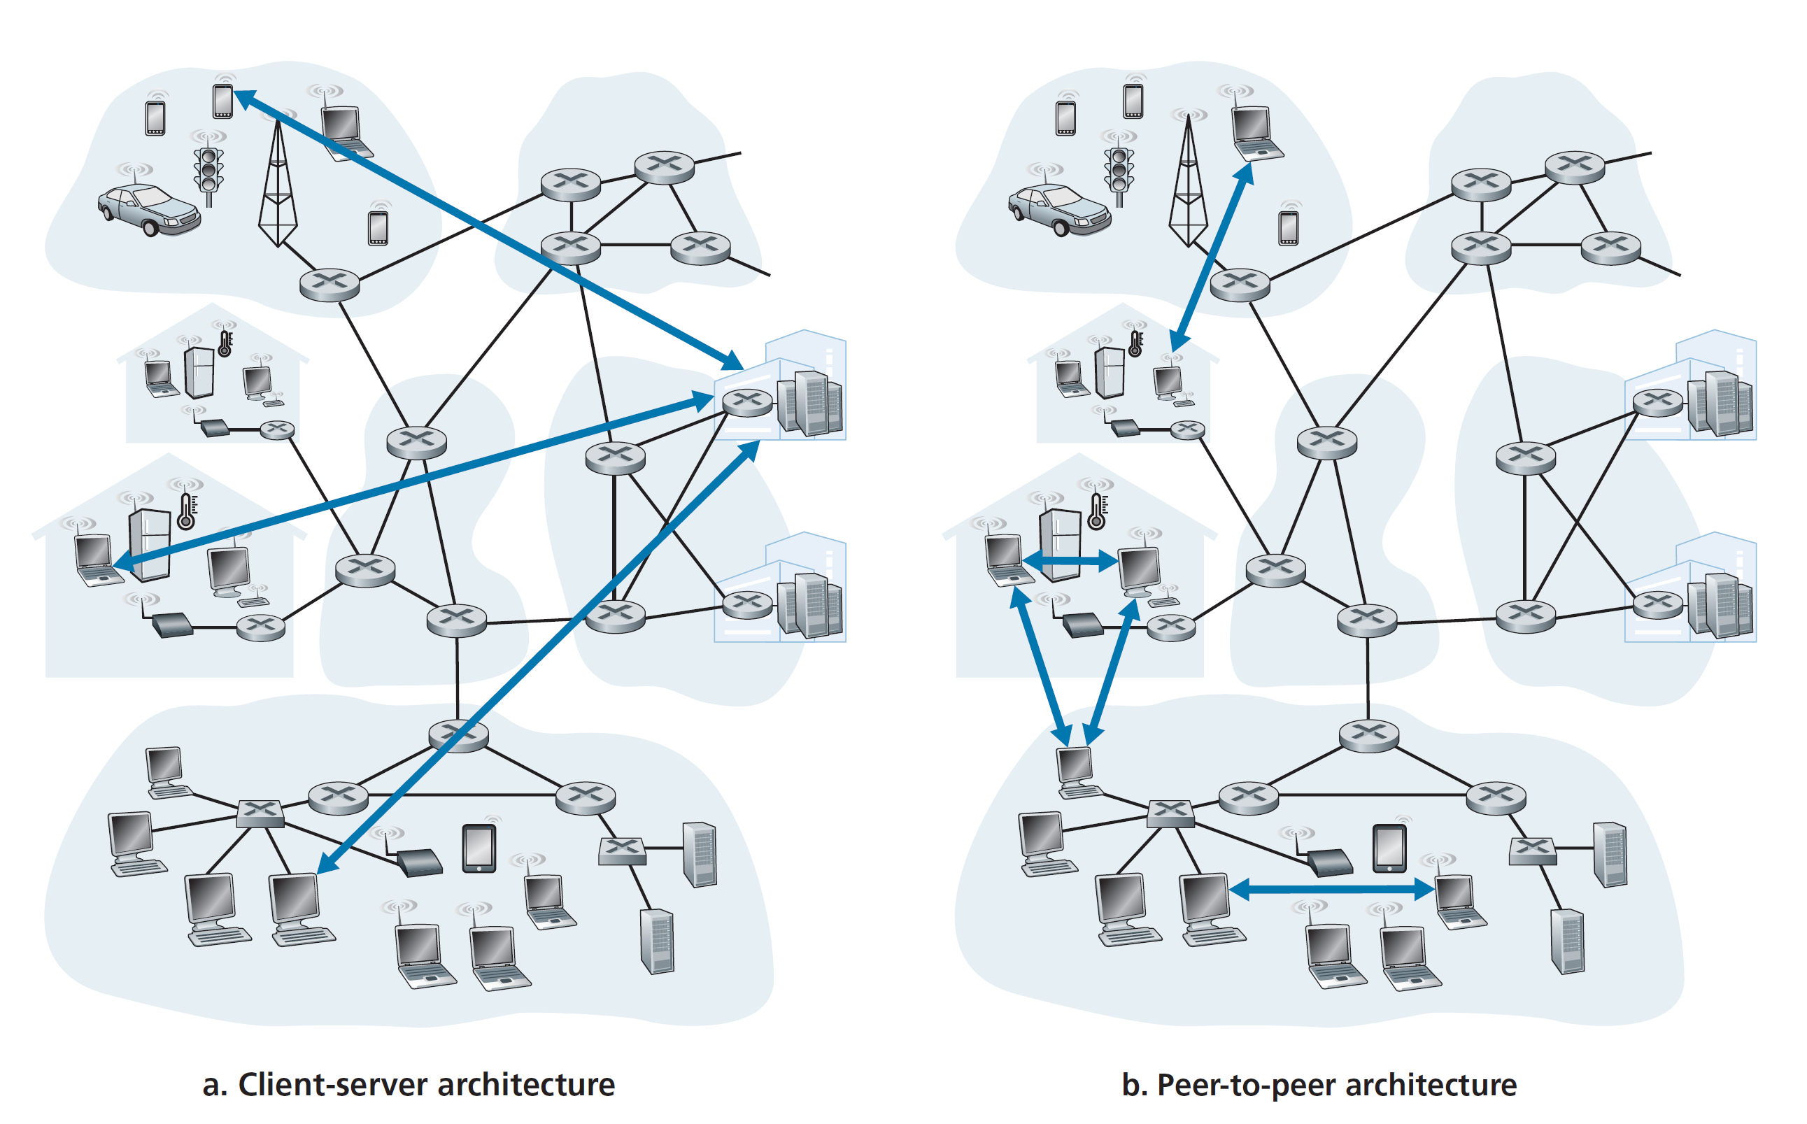

Slide 13
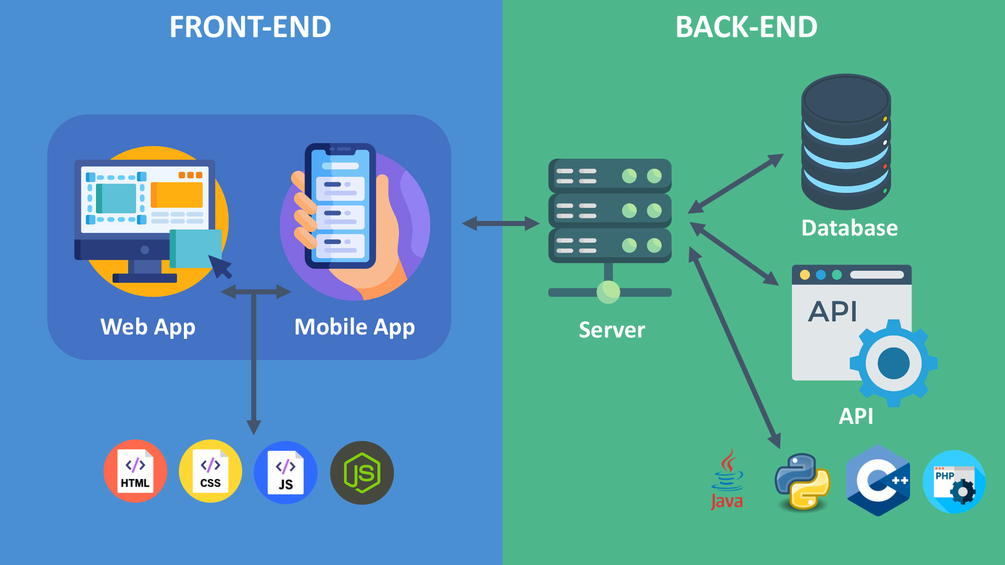

Slide 14
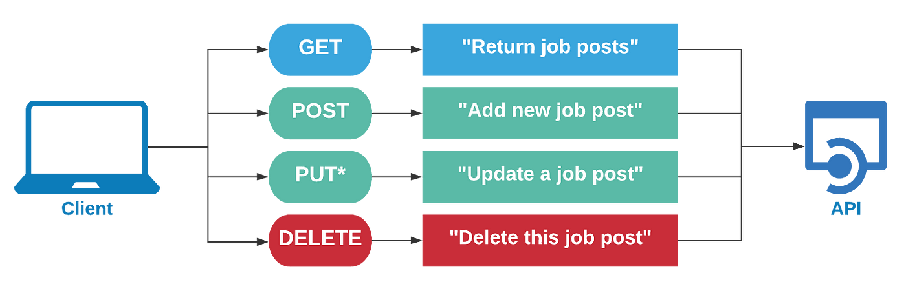
Application Program Interface
Notes:
mention: there is an API for program calls or libraries, and an API between systems in the internet

Slide 15
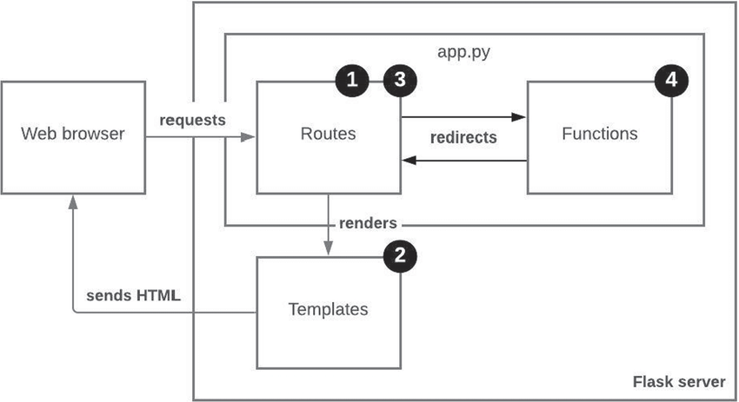
Flask
Flask - Python framework for web application

Slide 16


Cloud
Cloud Technology
Cloud Infrastructure, Platform, and Software as a Service
Notes:
Please, replace the image with a more suitable. Avoid removing the white shape!

Slide 17
Cloud Objectives
What is Cloud?
How do we use Cloud?
Do we need Cloud?
IaaS, PaaS, SaaS Different ways of Deployment
Pros and Cons

Slide 18
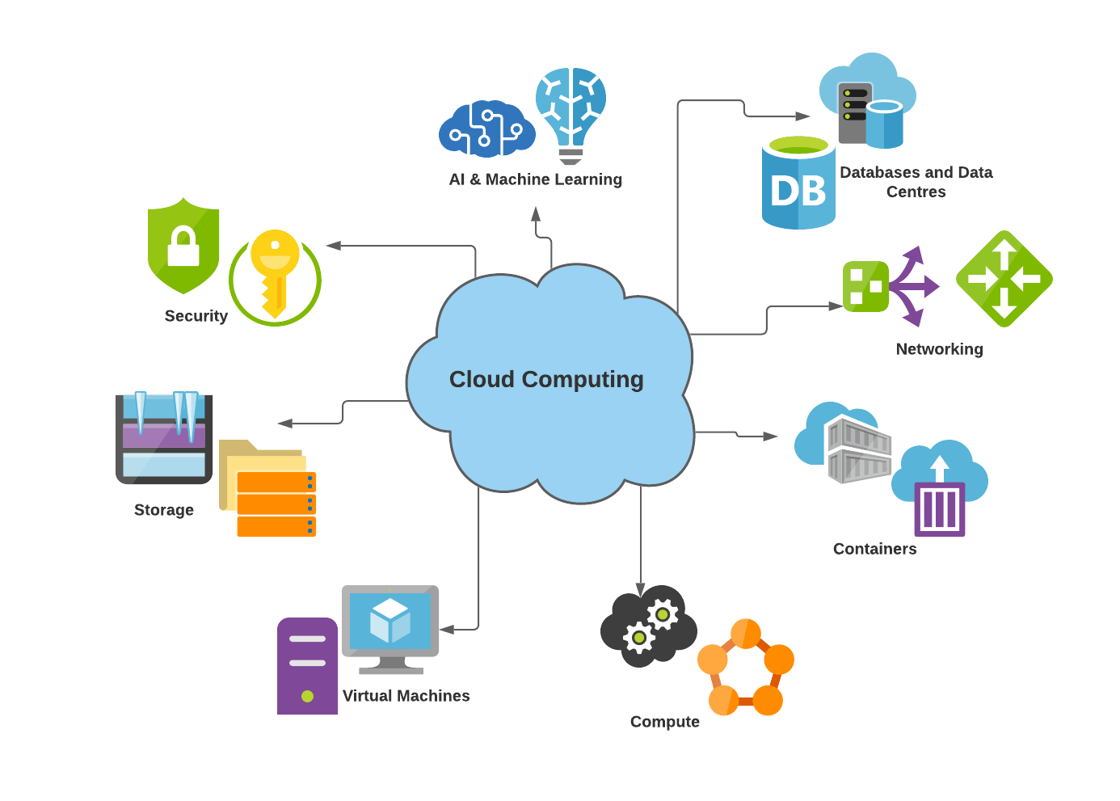

Slide 19
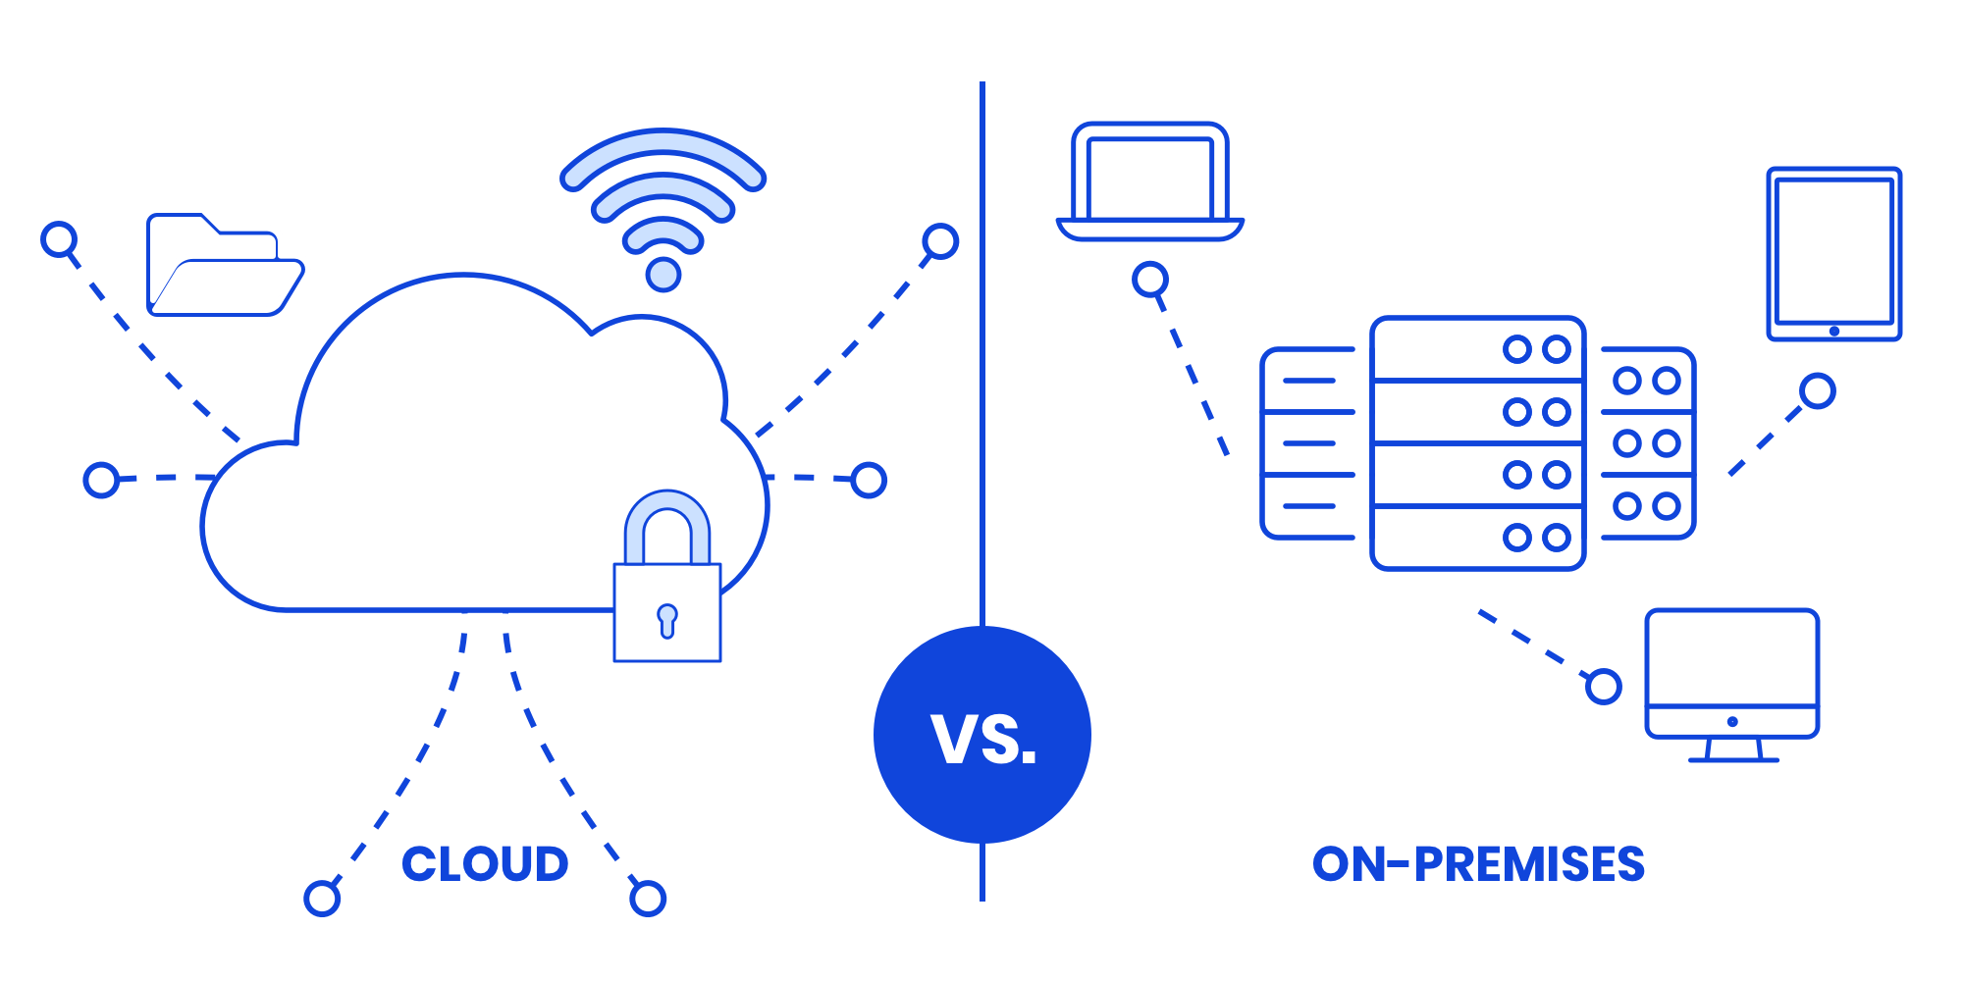
Cloud vs on-premise

Slide 20
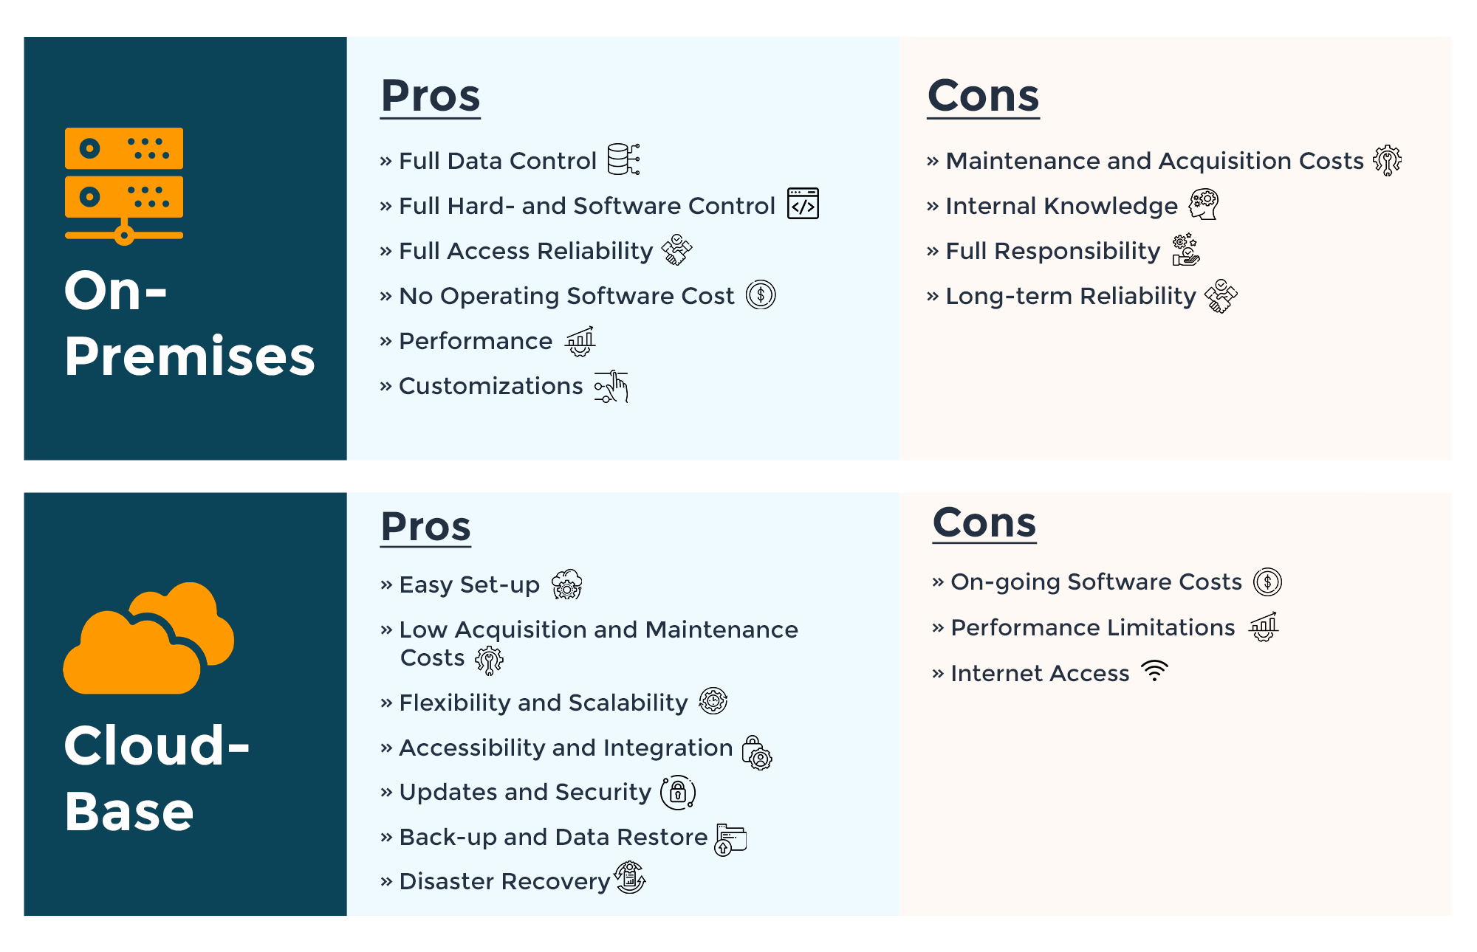

Slide 21
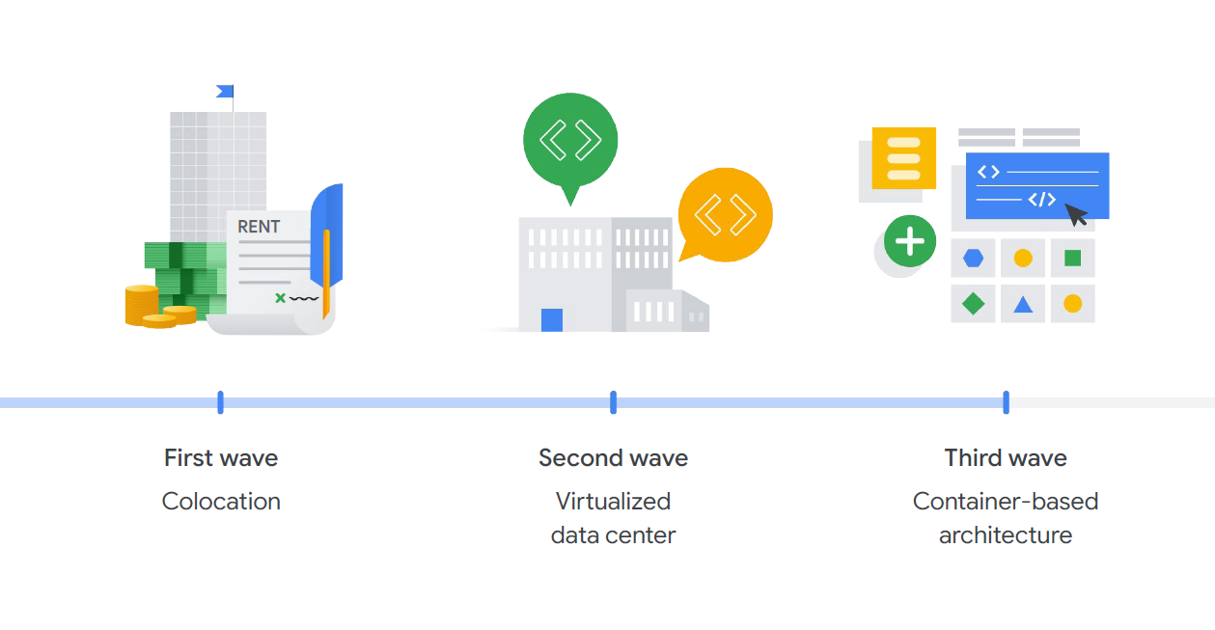
Evolution of Cloud

Slide 23



Cloud Providers
and many more

Slide 24
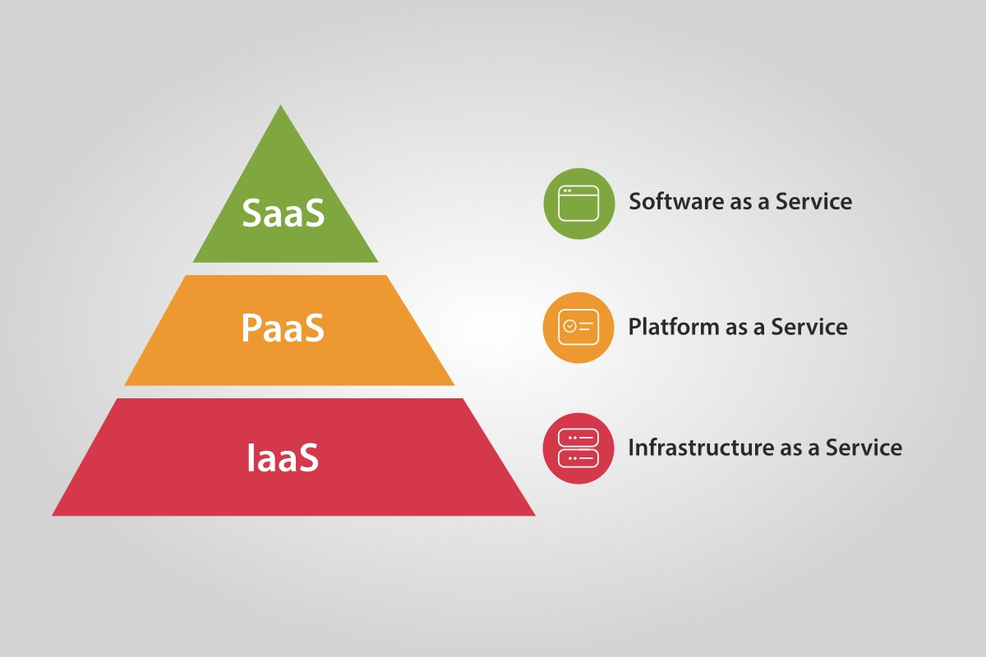
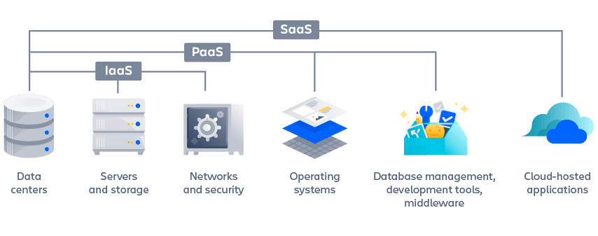
Cloud offerings

Slide 25
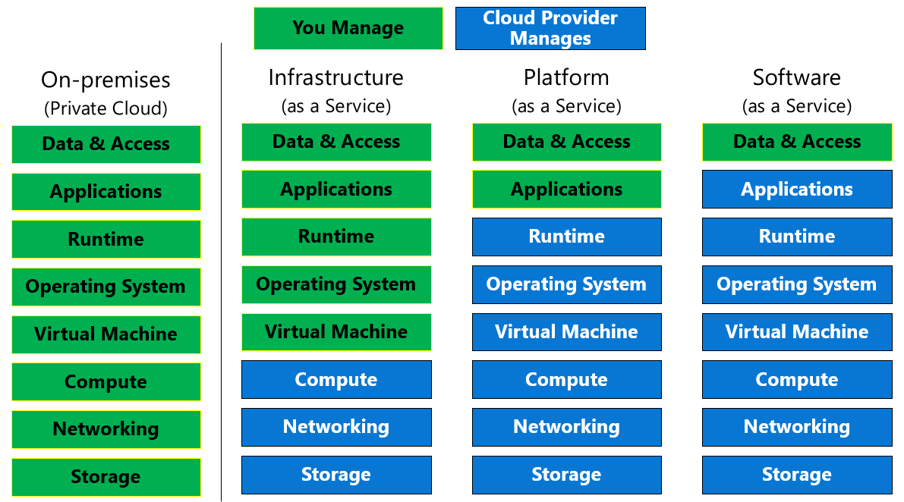

Slide 26
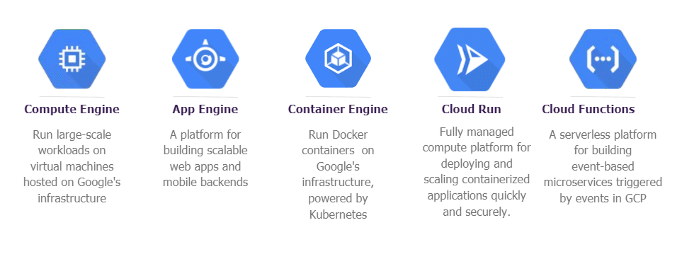
Deploying to Google Cloud
Compute Engine
App Engine
Kubernetes
Cloud Run
Cloud Functions

Slide 27
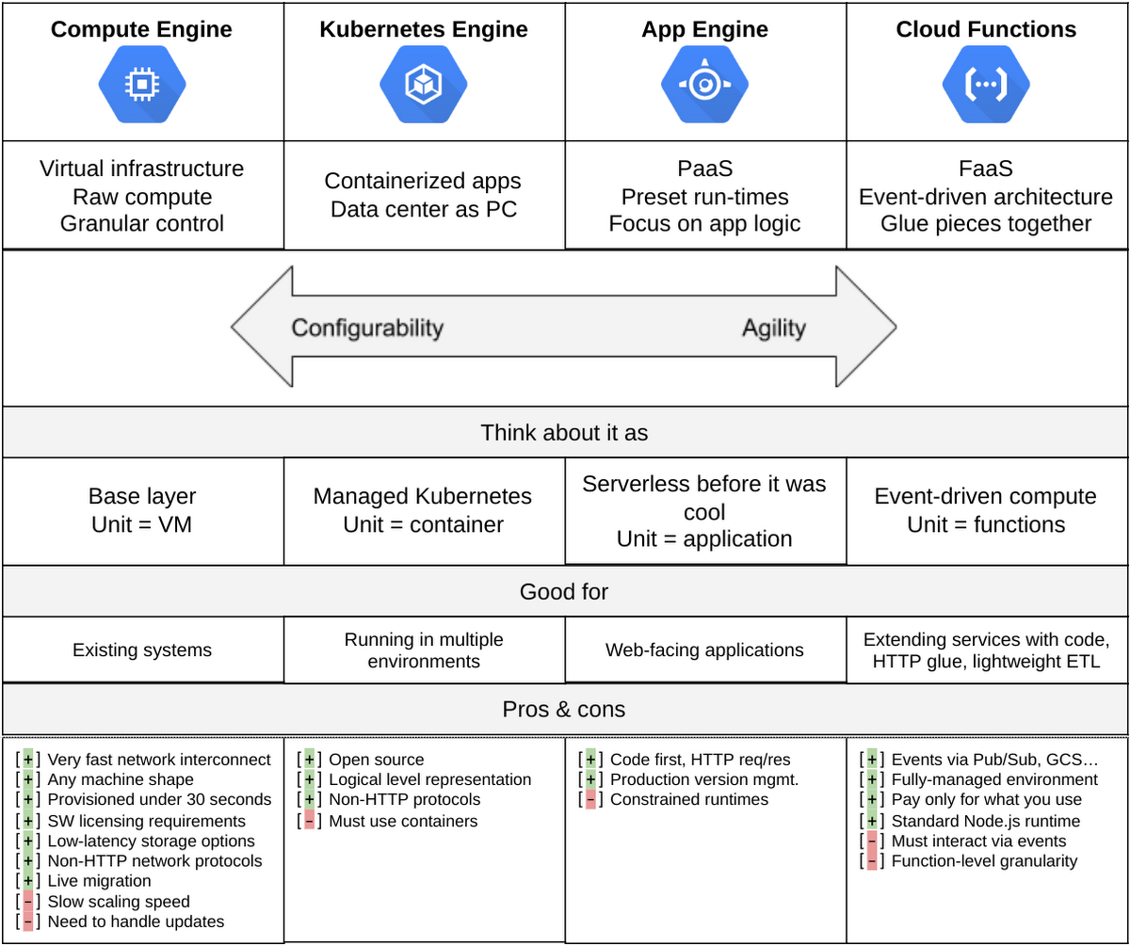

Slide 28
Costs in Cloud
Most of services are paid
Free trial period 3 month with GCP
Free tier amount for many services
Control usage Use budget limits
After trial period see what free tier offers, control usage and set budger limits

Slide 29



Google Cloud App Engine deployment
Notes:
Replace image with a new one

Slide 30


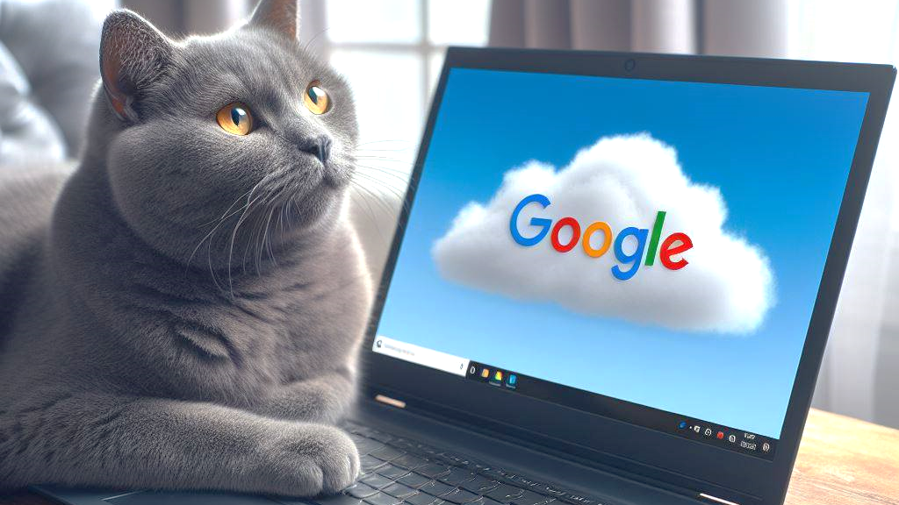
Breakout activity

Slide 31
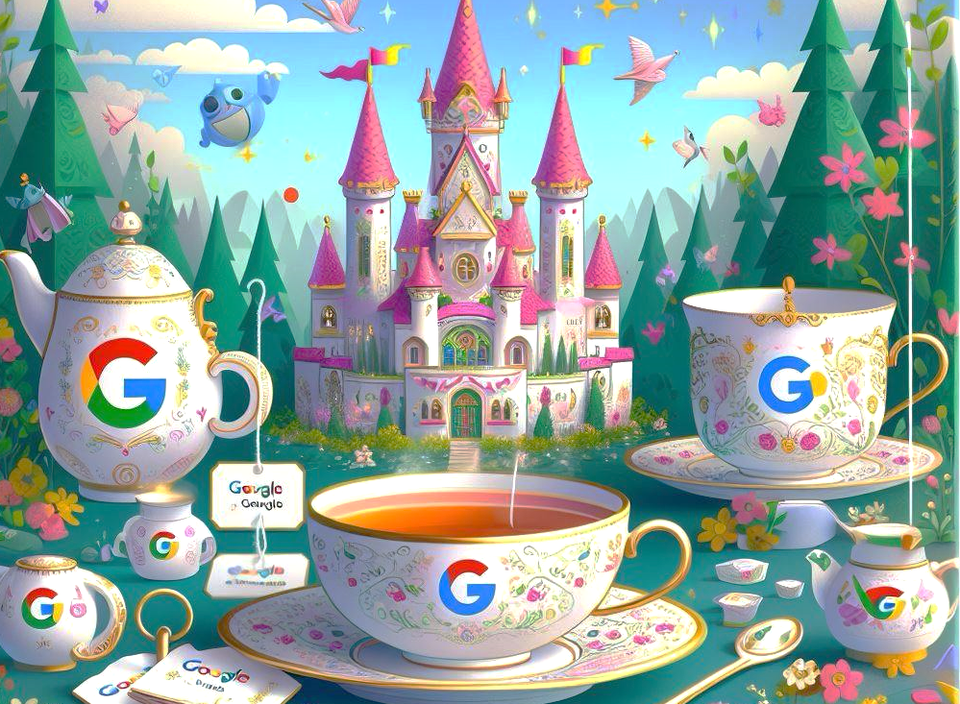
Breakout discussion
Notes:
Replace image with a new one

Slide 32

“
If you are a data scientist do you need to know about networking and cloud services?
Discussion

Slide 33

Advanced topics
More on Cloud
Cloud services and costs in cloud Further topics
Notes:
Please, replace the image with a more suitable. Avoid removing the blue shape!

Slide 34
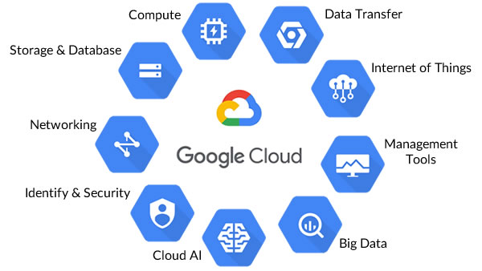
Google Cloud offerings
Google Cloud Developer Cheat Sheet

Slide 35
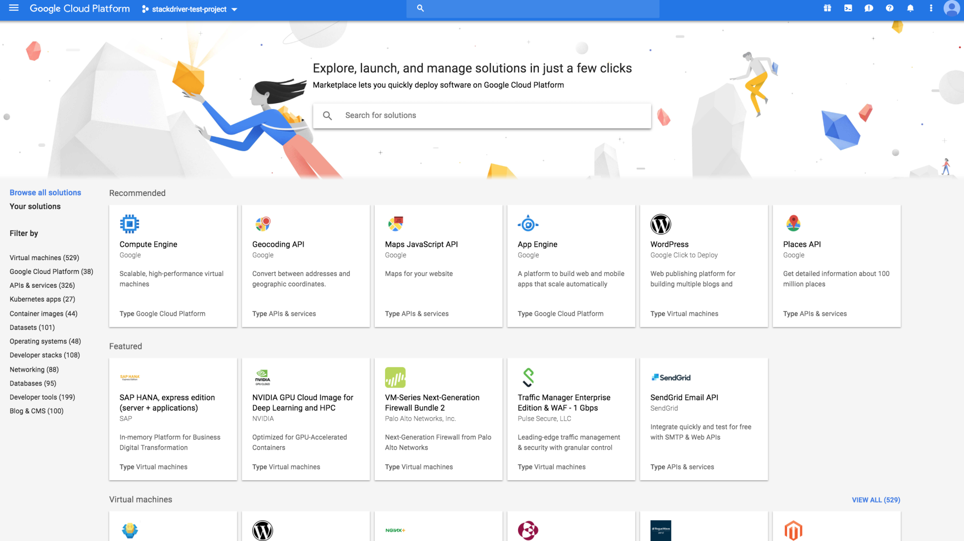

Slide 36
Further topics
Storage, SQL
Big Data
Containers
Continuous Integration / Continuous Deployment
Scaling Load Balancing
ML and AI in Cloud

Slide 37
Example of web application in GCP

Slide 38
Q & A

Slide 39

Thank You!

